Slide 1
Opportunity Pipeline Forecasting
Spring board Project
Case Study
Confidential
11-Jan-2023

Slide 2
Topics/Agenda
01
｜
Problem Statement
02
|
Data description
03
|
Data Preprocessing
04
|
Exploratory Data Analysis
05
｜
Model Building

Slide 3
01
Problem Statement

Slide 4
The client is a technology and chip manufacturing company. The sales group of the client have annual targets in $ that they need to sell. The client team is trying to achieve those targets by pursuing multiple opportunities across customers and business segments.
It is identified that, while a number of opportunities are being pursued, the sales group is lacking to quantify the potential of conversion of opportunities within a specific timeframe.
Our objective is to quantify the conversion potential of a sales pipeline portfolio, it can be realized by quality of an opportunity.
An opportunity: It is defined as a potential customer with specific asks of products in type, design and quantity with their $ values negotiated
Quality of an opportunity: How likely is an opportunity to convert within a specific timeframe?

Slide 5
02
Data Description

Slide 6
Opportunity Table
The data provided by the company is all Opportunities along with relevant product sells, across different customers from 2015 to 2016 - Q3
Provided with the opportunity ID
Transition from stage and to stage
Timestamps of the transition to and transition from stage
Name of the customer
Risk status of the opportunity
Opportunity creation and decision date
Opportunity status (whether it is open or closed/won or closed/lost)
Core consumption market
Core product segment
Core sales segment
Geography
Core product application

Slide 7
Understanding Pipeline Portfolio
6: Qualify
5: Define
3: Develop
2: Design
4: Design Win
Production Win
An opportunity can start at any stage.
If an opportunity reaches Design Win or production win, consider it as closed/won.
If an opportunity is cancelled or lost, consider it as closed/lost.
If it is in between stages then opportunity is open.

Slide 8
Transaction Table
In Transaction table, we have following features
Opportunity ID
Product ID
Product Segment Name
Product status
Product $: negotiated amount
Product quantity: quantity of the multiple products customer wants to buy
Decision date: a decision should be taken before this decision date
Snapshot time

Slide 9
03
Data Preprocessing

Slide 10
Data Preparation
Cleaned and merged datasets
Converted transition timestamps and snapshot time to datetime objects.
Encoded 'transition to stage', 'transition from stage name', 'customer name', 'risk status', 'opportunity status', 'core consumption market' and 'core product segment’, ‘geography’, ‘product status’ and 'opportunity type' as numerical values.
Removed duplicate rows.
Dropped product segment name column as it has only NA value.
After cleaning both datasets, we merged them using inner join on opportunity ID and decision date.
We dropped rows for which opportunity status was NA.

Slide 11
Data Engineering
Calculated time taken for transaction by subtracting ‘transaction from timestamp’ from ‘transaction to timestamp’.
Created cost per unit of product by dividing ‘product $’ and ‘product quantity’.
Created ‘days’ that represents the time taken for an opportunity from creation date to decision date.
Dependent Variable
Opportunity status is dependent variable.
We consider closed/win as 1 and other status like closed/lost and open as 0

Slide 12
04
Exploratory Data Analysis

Slide 13
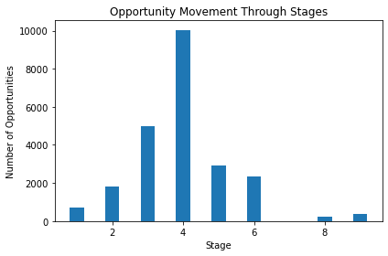
Transition between Stages
Here we plotted bar graph to understand how transition between stages is happening.
We plotted bar graph with stage number on x-axis and number of opportunities transitioned to that particular stage.

Slide 14
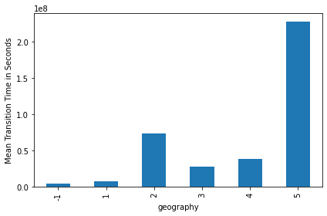
Stage Transition and Geographies
For this analysis, we have different geographies and mean transition time for each geography.
Here bar graph shows how mean transitional time varies for different geographies with maximum time taken in geography 5 and minimum in 1.
To further support, we performed ANOVA test and p-value comes out be 1.85e-64.

Slide 15
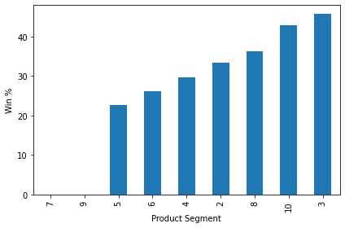
Wins and Product Categories
For this analysis we have 11 product and opportunity status true implies win.
Bar graph here shows the percentage of Opportunities that are won out of all Opportunities for each product segment, with the x-axis representing the product segments and the y-axis representing the win percentage.
Performed Chi-Square test to test dependency of product categories on win status,
P-value comes out to be 5.69e-40.
Product Cat | 2 | 3 | 4 | 5 | 6 | 7 | 8 | 9 | 11
Oppr Status
False | 12 | 11914 | 479 | 276 | 51 | 40 | 151 | 20 | 4
True | 6 | 9999 | 203 | 81 | 18 | 0 | 86 | 0 | 3

Slide 16
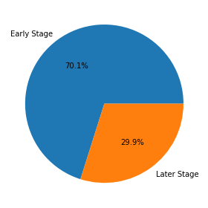
Losses in Early Stage
For this analysis, we defined stage 6 and stage 5 as early stages and other stages as later stage.
Here opportunity status True means loss.’
Pie chart shows the percentage of Opportunities that are in the "Later Stage" category out of all Opportunities that are either in the "Early Stage" or "Later Stage" category.
Performed Chi-Square test to test dependency of Loss and stage (early or later).
P-value comes out to be 0.
Transition to stage | Early Stage | Later Stage
Opportunity Status
False | 0 | 10396
True | 5232 | 7715

Slide 17
05
Model Building

Slide 18
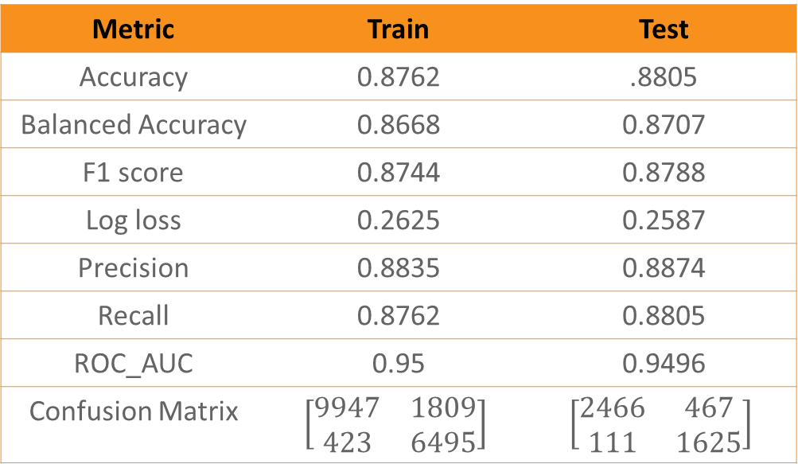
Model Summary
We trained SKLstatsmodelLogit model, for Threshold = 0.5 model summary is given below
Metric | Train | Test
Accuracy | 0.8762 | .8805
Balanced Accuracy | 0.8668 | 0.8707
F1 score | 0.8744 | 0.8788
Log loss | 0.2625 | 0.2587
Precision | 0.8835 | 0.8874
Recall | 0.8762 | 0.8805
ROC_AUC | 0.95 | 0.9496
Confusion Matrix | $$\left[\begin{matrix}9947 & 1809 \\ 423 & 6495\end{matrix}\right]$$ | $$\left[\begin{matrix}2466 & 467 \\ 111 & 1625\end{matrix}\right]$$

Slide 19
Observations from the coef. table
Features with p-value greater than 0.05(5% significance level)
  Transition to stage_5
  Product quantity
  Cost per unit
  Product $
Positive valued coef. Features
  Geography_4
  Geography_2
  Opportunity type_1
  Transition from stage name_5
  Product status_0
  Transition from stage name_4
  Transition from stage name_3
Negative valued coef. Features
  Risk status_0
  Transition to stage_5
  Cost per unit
  Core consumption for market_4
  Product status_1

Slide 20
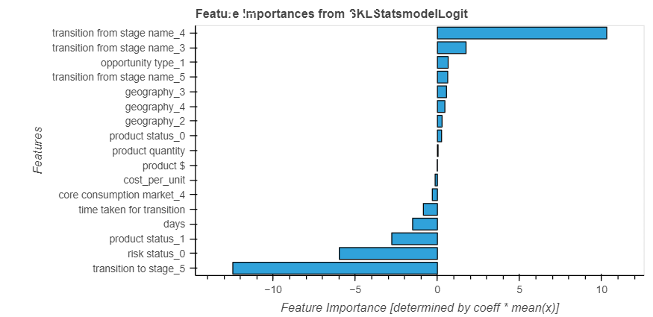
Feature Importance

Slide 21
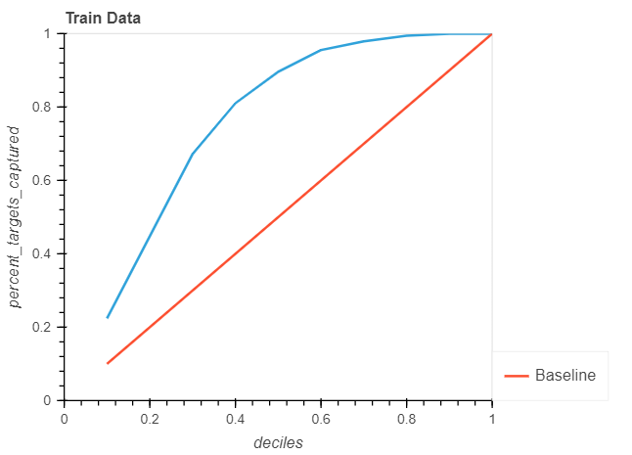
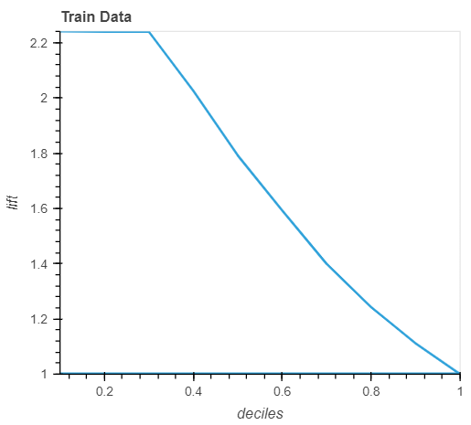
Gain Chart
Lift Chart

Slide 22
Thank You
Do you have any questions?
Presented by:
Atanu Mandal
Eswar Ungarala
Janaki Guggilla
Kirandeep Kaur

